Slide 1
Class 24 Firms, CEOs, and Taxes
What explain financial structure
Compensation
Schemes
CEOs
Example
2. Taxes and balance sheets
Debt and equity
Accounting and depreciation
4. Financial Regulation

Slide 2
Firm as hierarchy
Tasks and outcomes
Compensation depends what the supervisor can observe.
Wages
Promotion and bonuses
(call) Stock options

Slide 3
Why pay wages
Cost of wages
Monitoring is necessary
When to offer wages
Routine tasks that are easily described
Individual output is easily observable
Benefits of wages
Low risk for the employee
Less sharing of upside (for stockholders)
Note piece work and wages here are equivalent

Slide 4
Why use bonuses and Promotions?
Cost of Bonuses
Expensive and sharing of upside
Cost of promotions
Limit recruiting to key jobs to insiders
When to pay B&P ?
Tasks hard to describe (contract incomplete)
Effort hard to measure
Can monitor individual output.
Benefits of B&P
Employe has target and get a non-linear payout

Slide 5
Why use stock options?
Benefits of options
Focus employees on the upside of the firm
Reward risk taking
When to use options
Employees with a lot of discretion/authority
Hard to monitor individual effort
Cost of stock options
Dilute equity
Reward every option holder based on aggregate not individual performance

Slide 6
Part 3: The CEO as an Agent
Shareholders do not manage the firm they
Delegate to management to the board of directors who appoints the executive officers (CEO…)
They can vote out the board of directors but most often they cannot fire the Executive officers directly.
Management has (temporary) control
But it does not own the firm.
So it faces incentive problems: it has to work to make the company profitable, but if it gets a wage it does not care about outcomes

Slide 7
Example: Incentives for decision maker
Example based on the financial structure of the Citroën company—the first European company to introduced the assembly line
In 1928 Citroën had 800,000 shares outstanding, with a par value of 500 francs. They pay a minimum dividend of 35 francs (7%).
André Citroën,the founder, owns 200,000 shares
And via founders’ shares has the right to 30% of the profit above the dividend.

Slide 8
Income rights
Financial structure
300 million of debt (D)
Gets payoff first and is fully paid when cash flow (π= rD)
400 million in equity (E)
Gets payoff second if π >rD, minimum dividend fully paid when π= rD+0.07E +min
Founder’s shares
Gets payoff second if π >rD+0.07E
then gets 0.3π-rD-0.07E
Both of the last two are options
Different strike prices (on cash flows)
Notice pays off do not have slope of 1 (as in standard option).

Slide 9
Lazard Frères is the investment bank
They own the debt
Andre Citroen has all his wealth in the firm, and wants to diversify
Design the public offering
Citroën has control (66% of the votes) but has to keep 85% of his shares and keep control
Transform the founder’s rights into 750,000 share that Citroën can put on the market

Slide 10
incentives
When Citroën sells stock, he increases the relative importance of the high strike price option
More risk-taking
When Citroën sells founders’ shares, he increases the relative importance of the low strike price option.
less risk-taking
Changes in portfolio affect incentives Lazard Frères wants the second outcome

Slide 11
What happens
In 1934, the firm is in great difficult, and André Citroën pledges all his shares to Michelin his primary creditor to secure one more loan
Then, Citroën still owns 178,000 shares of the firm and 200,000 founder’s shares. So he sold about
10% of his equity (the low strike option)
73.3% of his founders shares (the high strike option)
Good for the bondholders.
Note:Citroën still goes bankrupt because of the Great Depression. Michelin exercise their option on André Citroën’s shares and own the firm

Slide 12
The problem of control in large firms
Ideally firms work to maximize shareholder value
Management is the agent of the shareholder
In practice management is in control
Current board and current CEO chose new board members and as long as firms are reasonably profitable, shareholder votes are pro-forma
Problem is that management does not want to maximize profit. It wants to maximize its return (value of option….likelihood of business, likelihood of remaining in job)

Slide 13
Management in control
Pay for performance solve some of this but
Can induce either not enough risk taking
Management does not care enough about the up side return
Because management is risk averse
Can be too much risk taking
Management does not care enough about the down side
Lots of option that are not in the money (S<K)
This is hard to fine tune

Slide 14
Management in control
Also induces issues about the level of compensation.
Management’s private incentives are not to minimize compensation
Look at some figures and tables from
Carola Frydman and Raven Saks. Executive Compensation: A New View from a Long-Term Perspective, 1936-2005 . (RevFinStudies 2010)

Slide 15
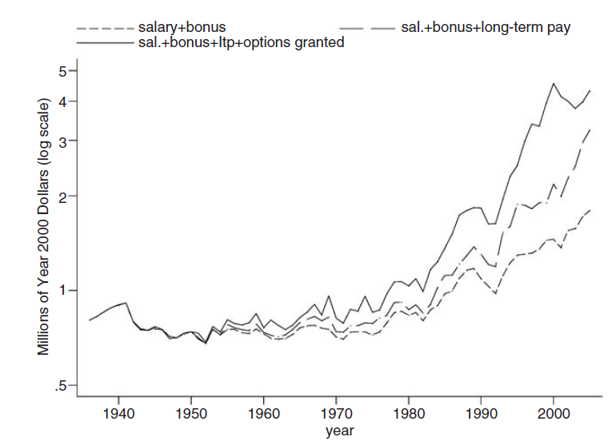
Frydman, Carola, and Raven E. Saks. "Executive compensation: A new view from a long-term perspective, 1936–2005." The Review of Financial Studies 23.5 (2010)

Slide 16
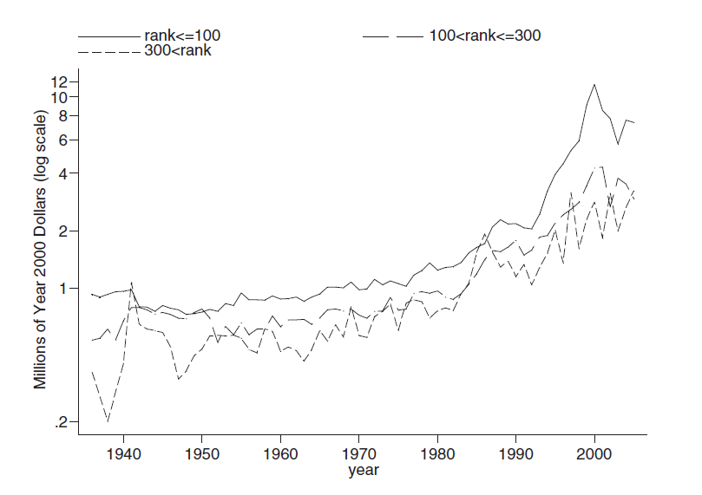
Frydman, Carola, and Raven E. Saks. "Executive compensation: A new view from a long-term perspective, 1936–2005." The Review of Financial Studies 23.5 (2010)

Slide 17
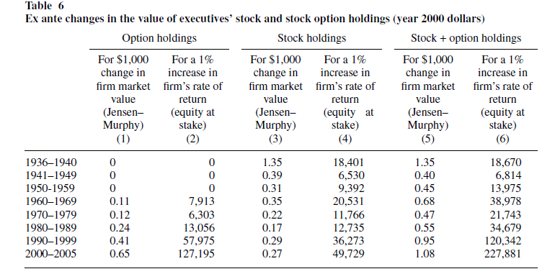

Slide 18
Taxes and Finance

Slide 19
Pyramids
How profits are taxed affects organizations
Company A worth $102 million wants to control a supplier B worth $100 million
1. issue $51M and buy 51% of B
2 issue $100M and buy 100% of B
Which do you choose?
Key part of General Electric early 20th century expansion, ruled out by reforms in the 1930s,
Tender offer have to be made for all of the stock.

Slide 20
Taxes matter
1. issue $51M and buy 51% of B
Cheaper
But if profits from B are taxed at B and then again at A
not so good.
2. issue $100M and buy 100% of B
More expensive
Avoids the double taxation of profits at A and B
Tax in US is 2. Tax in Korea, Japan, and Italy is 1.
Where are the pyramids?
Note:
it also matters how tender offers are made. In the US you can’t make a tender offer for 51% (more on regulation)

Slide 21
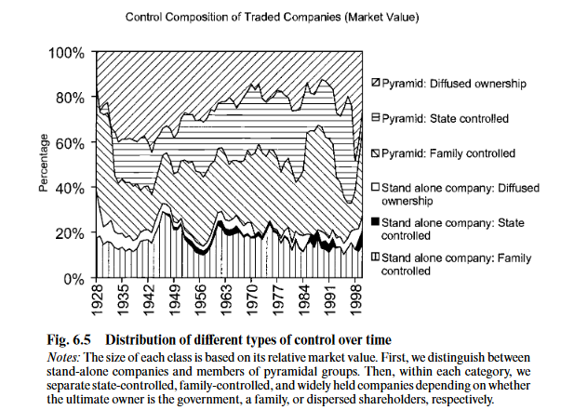
The History of Corporate Ownership in Italy Alexander Aganin and Paolo Volpin 2005

Slide 22
A dollar saved is a dollar earned

Slide 23
Taxes and balance sheets
Debt and Equity
Cash flow to debt is cost (not taxed as a corporation)
Cash flow to equity is profit
Depreciation
Depreciation is a cost. The rate is something government has to agree to
Compensation
Some forms of compensation taxed as income
Some forms of compensation taxes as capital gains
Carried interest provisions for privately held firms.
Some forms of compensation are costs
Health care expenses

Slide 24
Taxes and debt and equity
Interest is a cost, Dividend is a profits
Firm market value $2 billion and $100 million in profits
Owes 21 million to government.
Net payment to investors $79M; Dividend yield= 3.95%.
It borrows $1 billion dollars and buys back $1 billion of equity. Interest rate is 5%. Cost of debt 50 million
Net profit is 50 million => tax liability has gone down to 10.5 million. Net payment to shareholders $39.5M
Income to investors goes up.
50 (bonds) +39.5 (equity)=89.5
If can borrow at dividend yield
Stock price goes up. (interest charge is $39.5 net income to shareholders is $47.8m)
Why not all debt?

Slide 25
Taxes and debt and equity
Important
Increasing leverage here is simply tax avoidance
Not efficient because total profits of the company are constant
Has a cost. Increased risk of bankruptcy.
Quite different from the leverage arguments we saw earlier

Slide 26
Dividends vs stock buybacks
Another tax arbitrage
Firm level
Dividends are taxed as profits
Retained earnings are taxed as profits. Can use to buy back stock.
Individual level
Dividends taxes as income taxes (20+%)
Stock buybacks are taxed at capital gains (20%)
Again no efficiency gain, just tax avoidance.

Slide 27
Depreciation
Depreciation is a cost (not a fiction)
Example Solar panels
Fail at 0.05% initially. Degrade at 0.5% a year. (inverters are another pb)
Install a solar field of 100,000 panels. Replace 50 a year (no big deal). Budget for this (cost)
Output is falling from degradation so the (technical) value of the field is falling. Need to deal with this loss.
Both losses are depreciation.
Ideally measure cost of replacement due to failure and the technical output due to degradation and draw down the residual value of the investment.
In practice, industry sets depreciation schedules with the government.
Why is this a good idea.

